Slide 1
ETL service
Requirements and analysis model

Slide 2
Product description
ETL service for private data cleansing Data quality and availability is important for applications running in the framework. The framework defines so-called data modules stored on S3 or in a RDBMS. A data module is described by a json-ld compatible metadata, a collection protocol and the versioned data. The ETL service would extract data from internal corporate systems, cleanse, merge, anonymize, transform the data and upload it to a new version of a data module. Then the module can be used by machine learning applications deployed on the framework.
Team: Anoshenko Daniil, Rogoza Kirill, Sergey Rogachev, Pham Manh, Denune Pravira
Repo: https://github.com/Neovodoo/ETL

Slide 3



Roles
DevOps Engineer
Devops engineers can integrate our service into products for continuous delivery of dataset to the trained model
Data Scientists
Can get good transformed dataset from source data as output of our service
Project Manager
Can initiate integration of our product into projects to decrease time for update their trained models in near real time mode

Slide 4
Story map

Slide 5
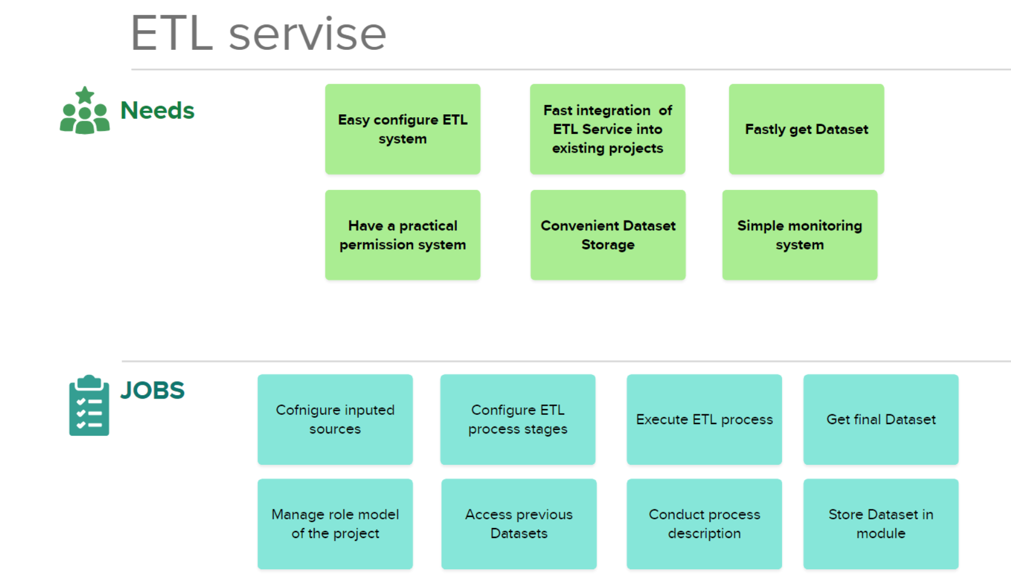

Slide 6
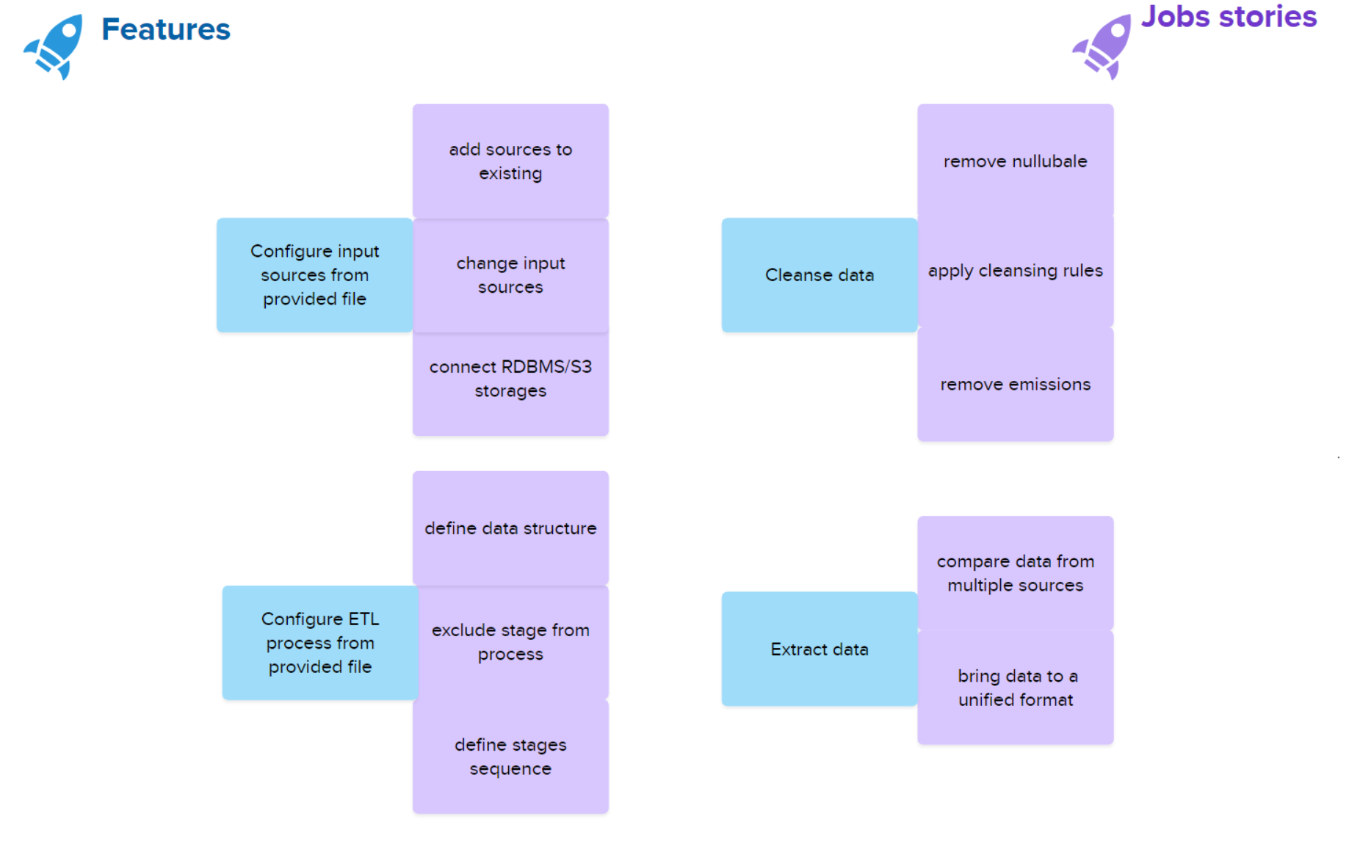

Slide 7
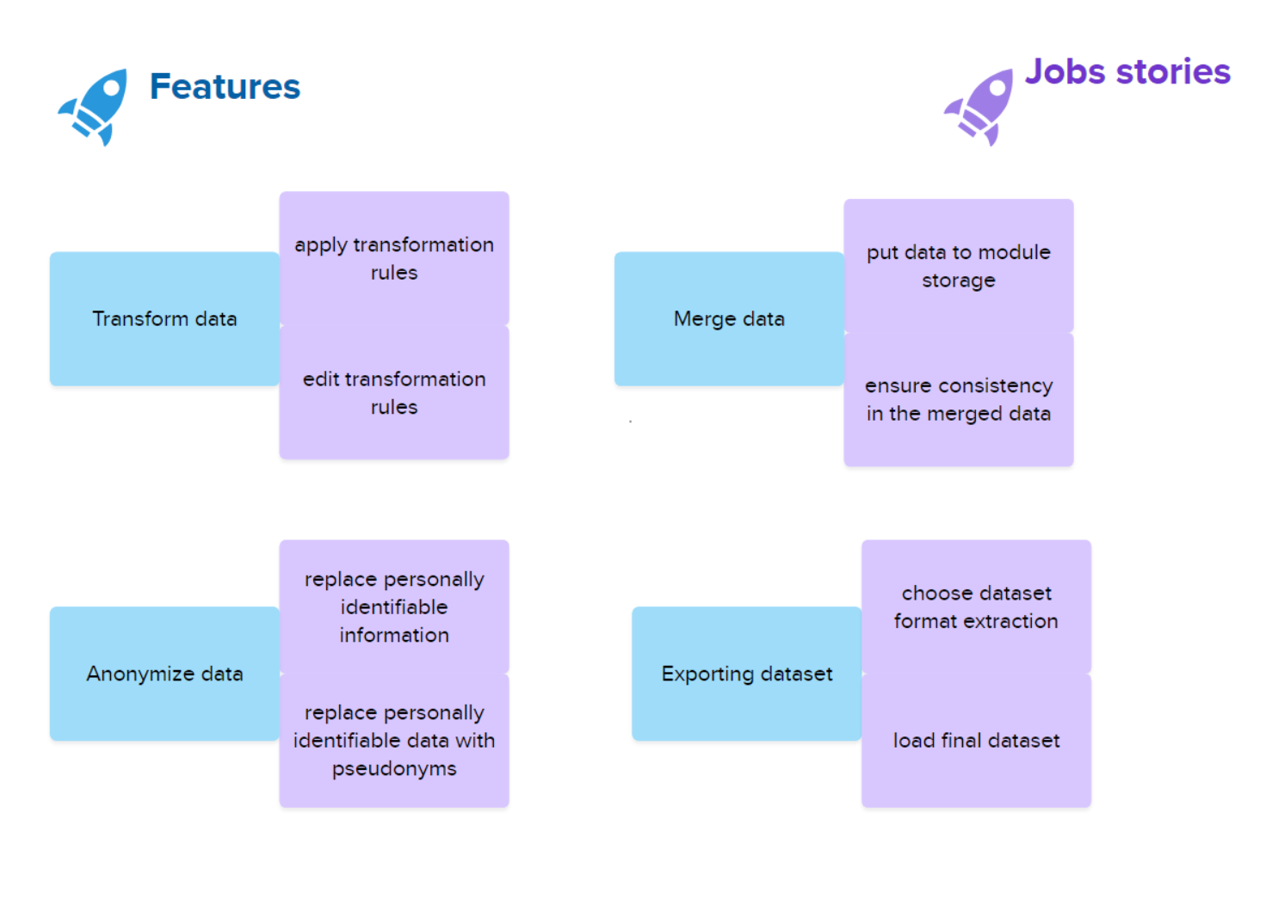

Slide 8
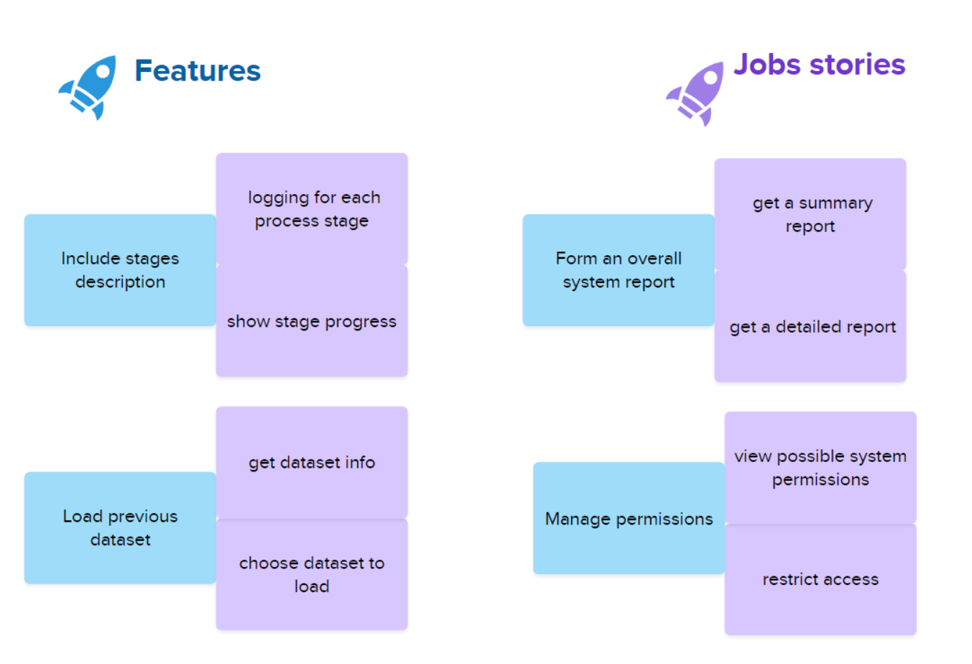

Slide 9
Use case diagrams

Slide 10
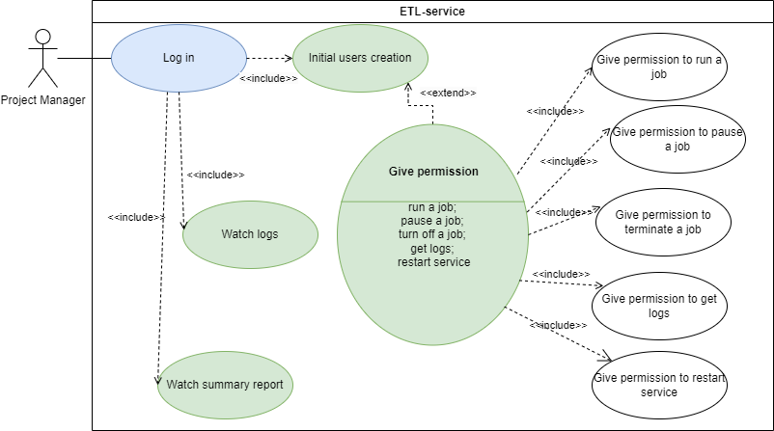

Slide 11
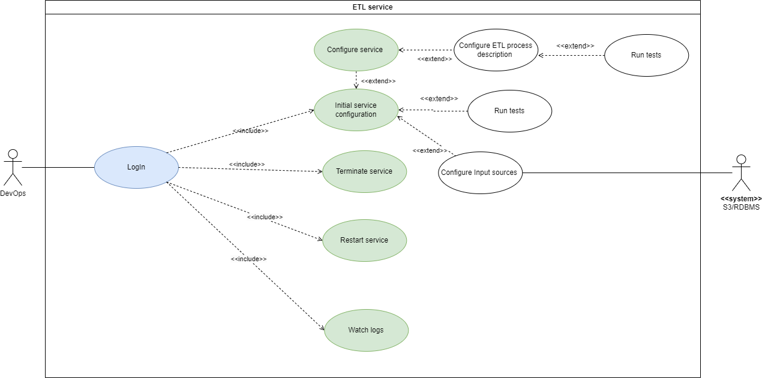

Slide 12
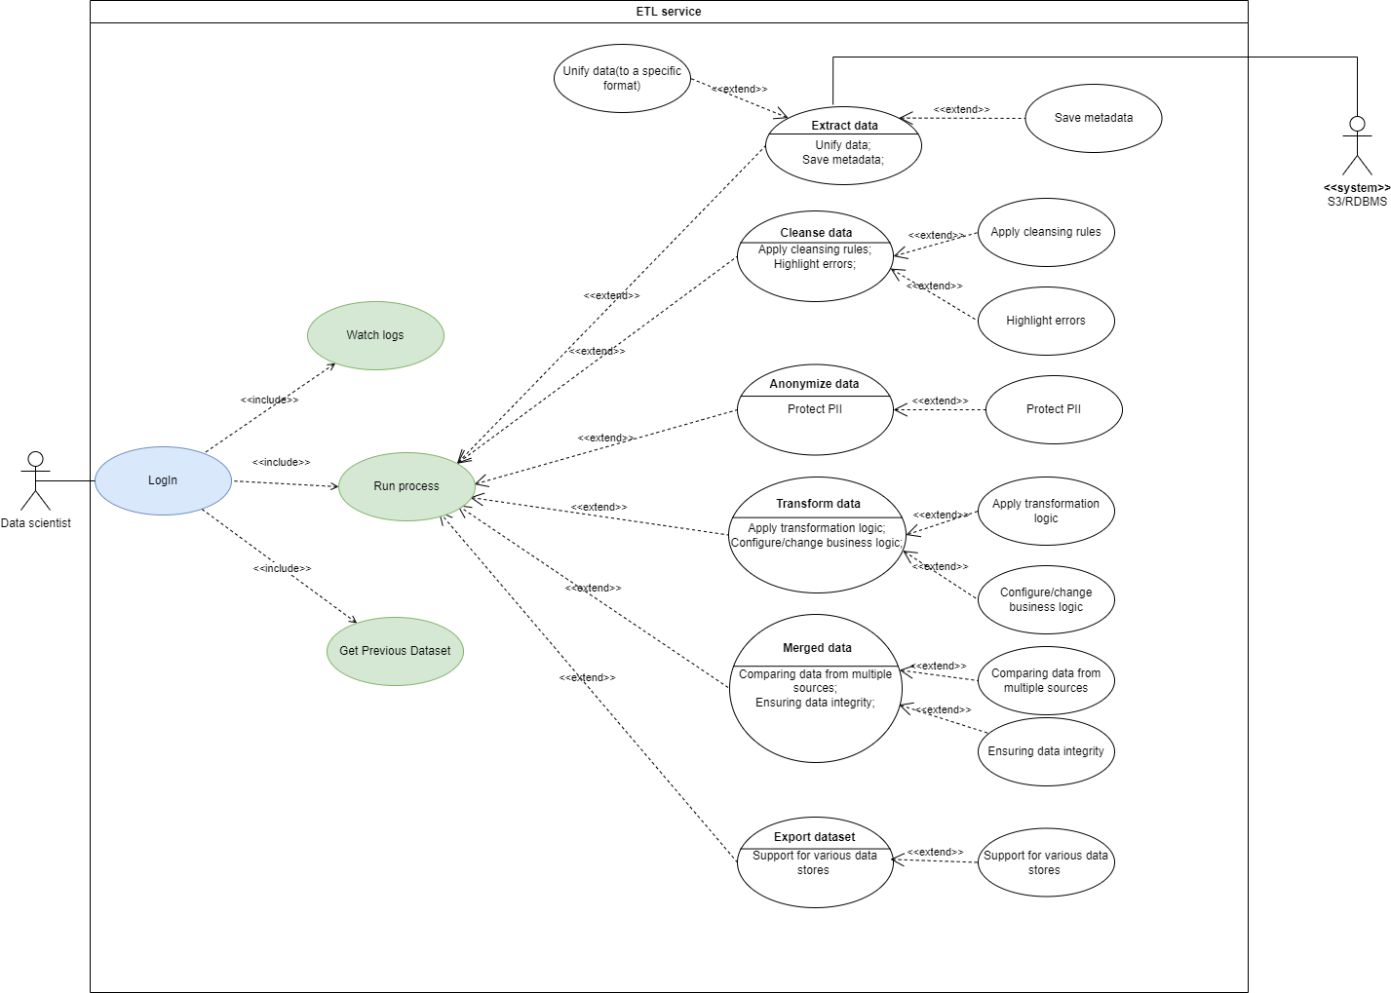

Slide 13
Interaction analysis

Slide 14
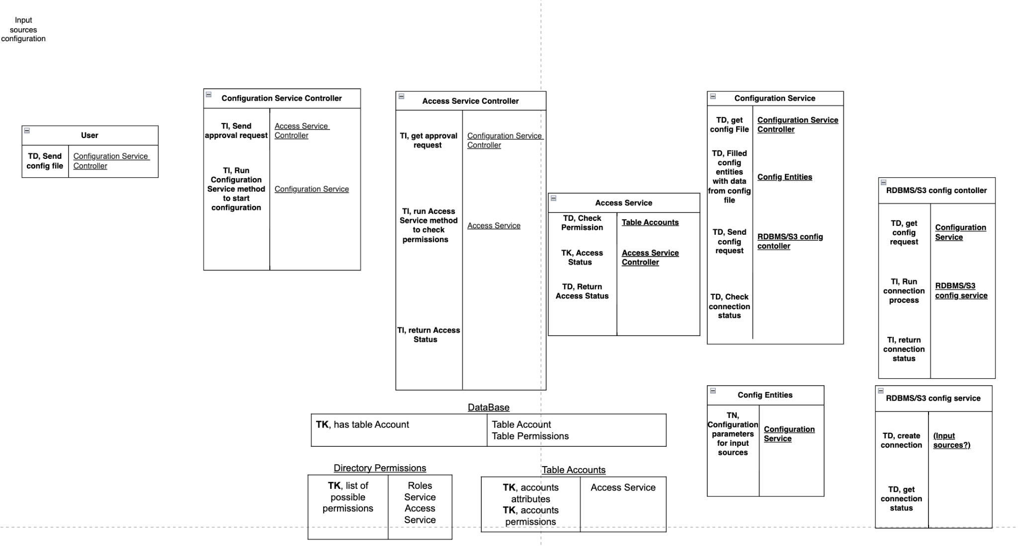

Slide 15
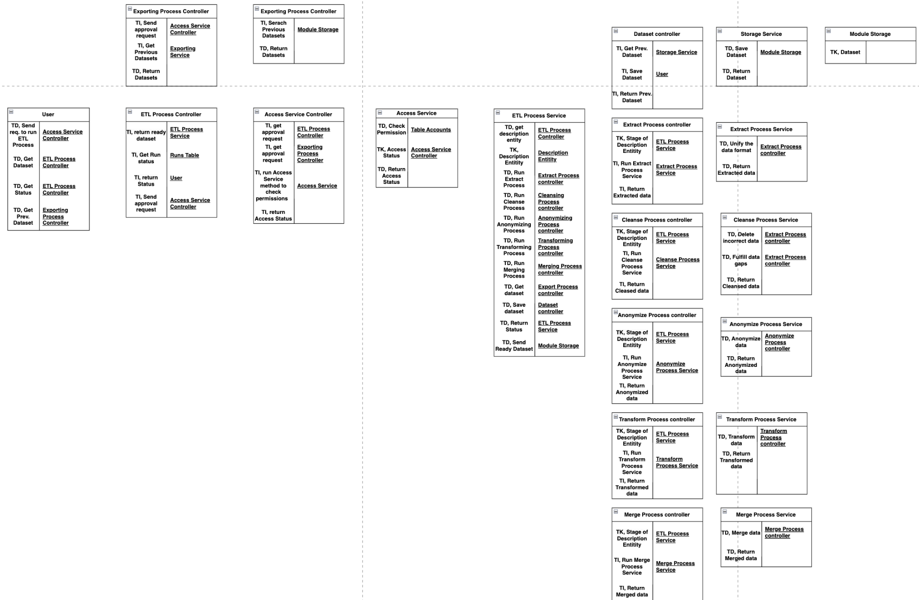

Slide 16
Final class diagram

Slide 17
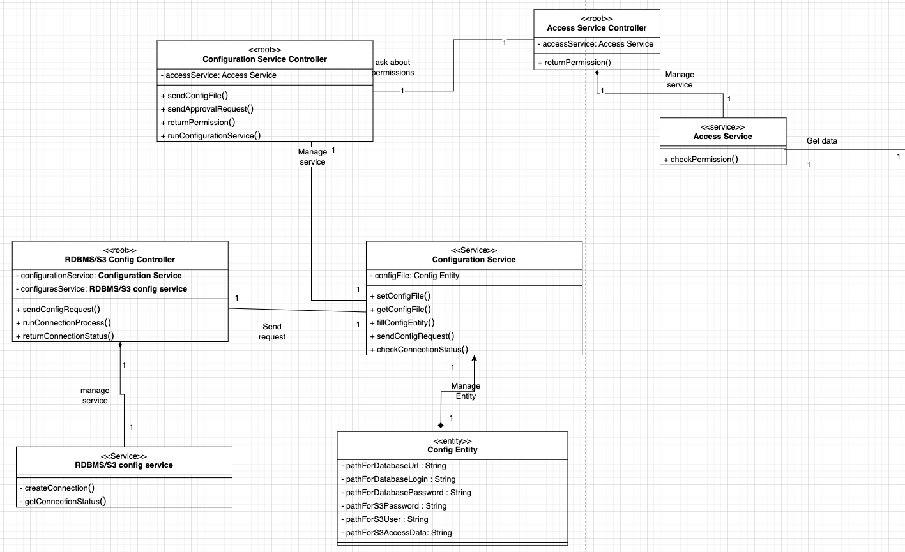

Slide 18
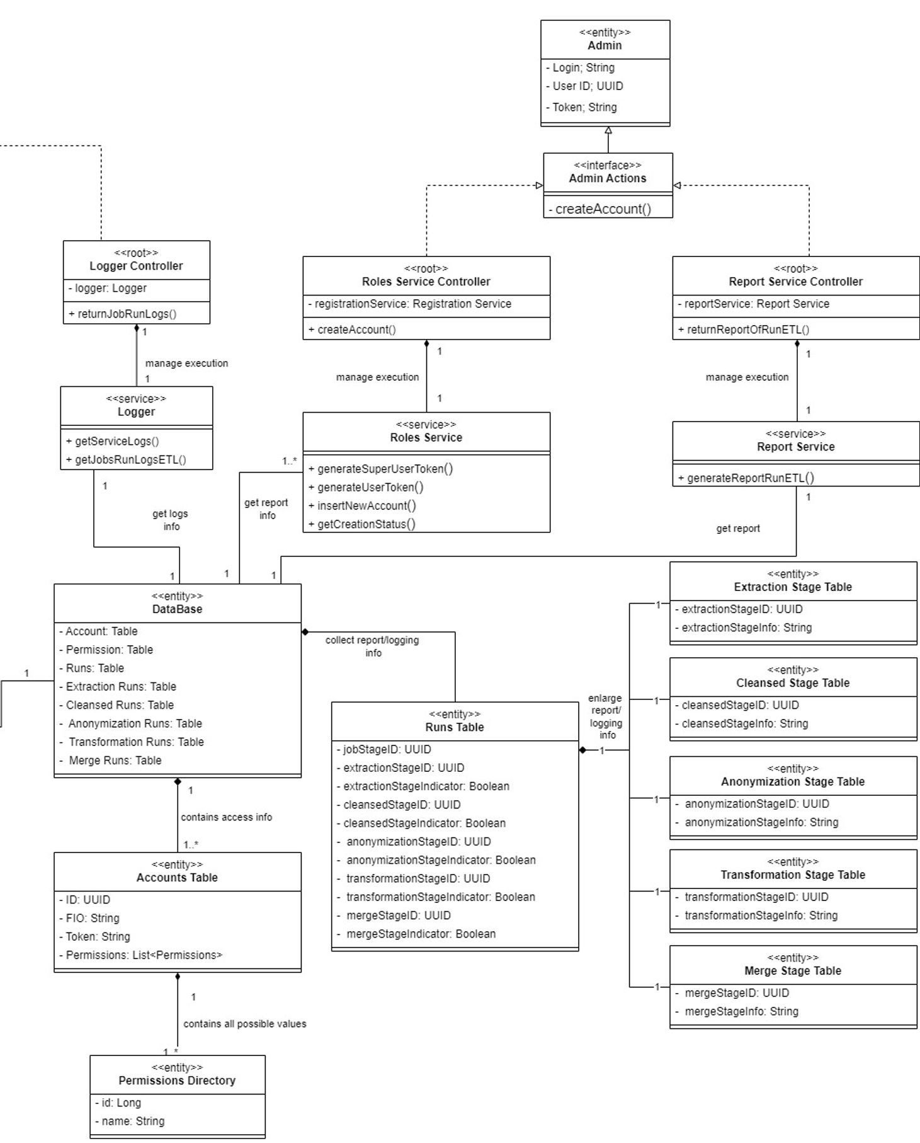

Slide 19
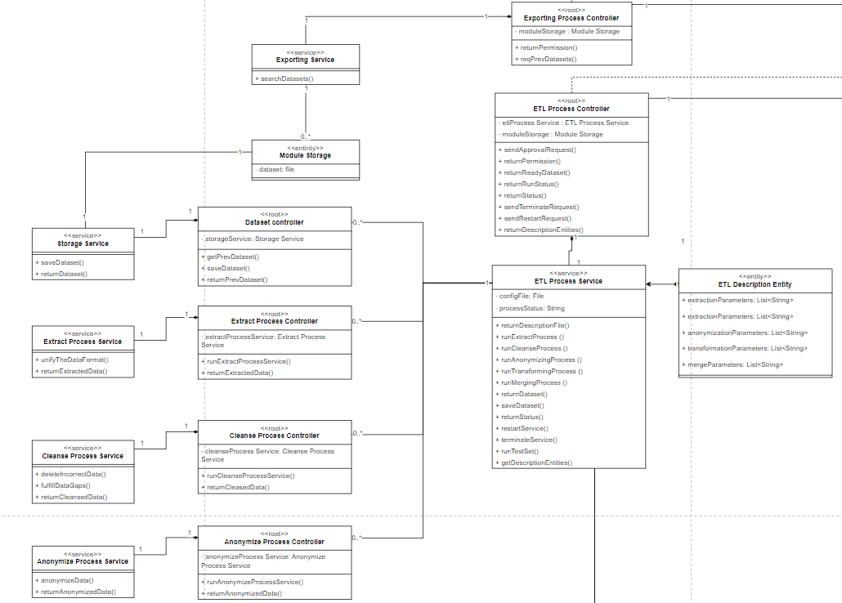

Slide 20
Detailed behavior

Slide 21
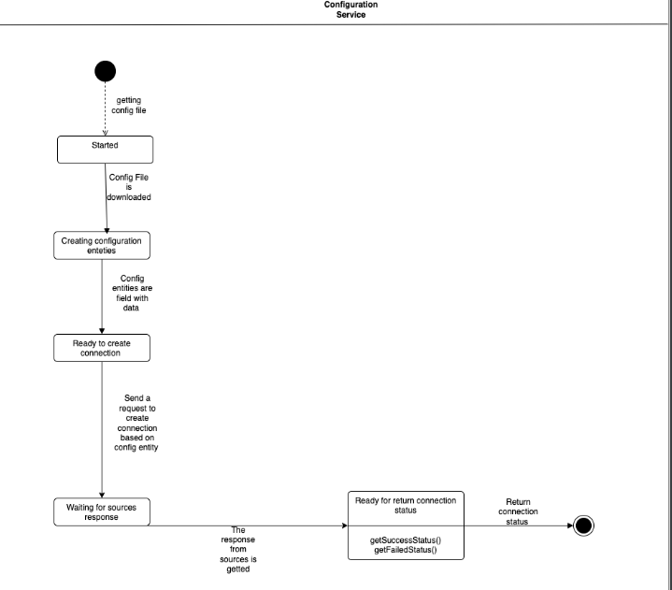

Slide 22
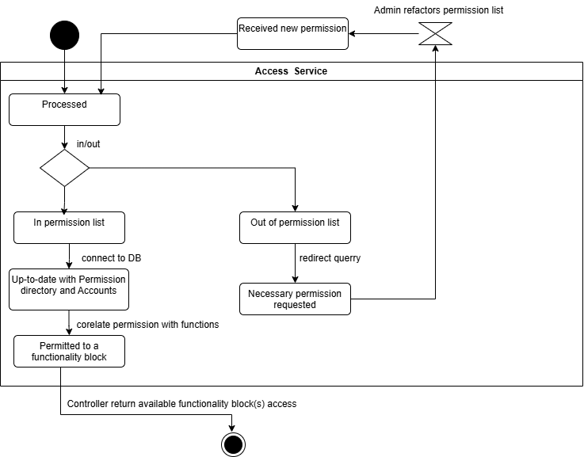

Slide 23
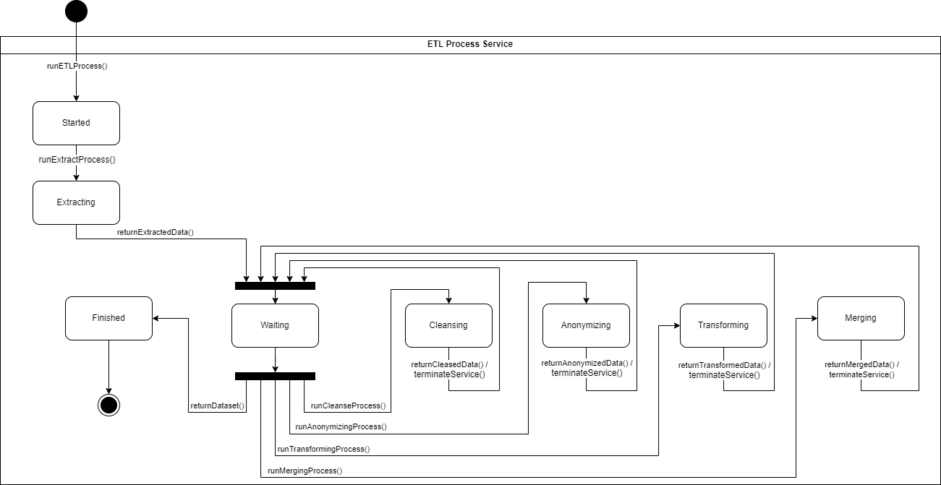

Slide 24
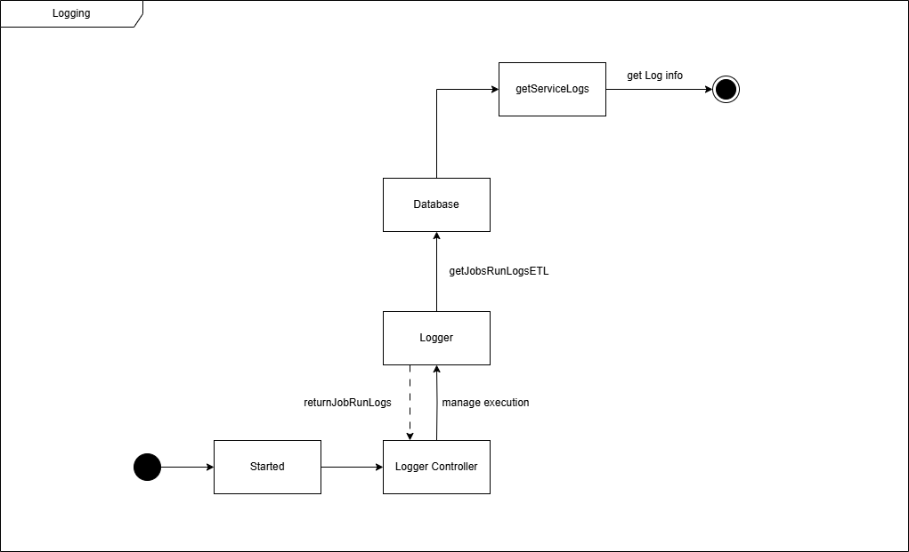

Slide 25
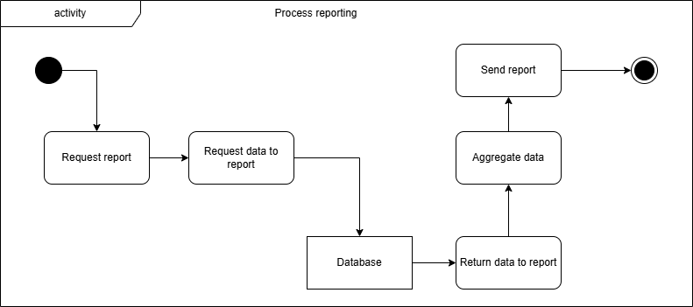

Slide 26
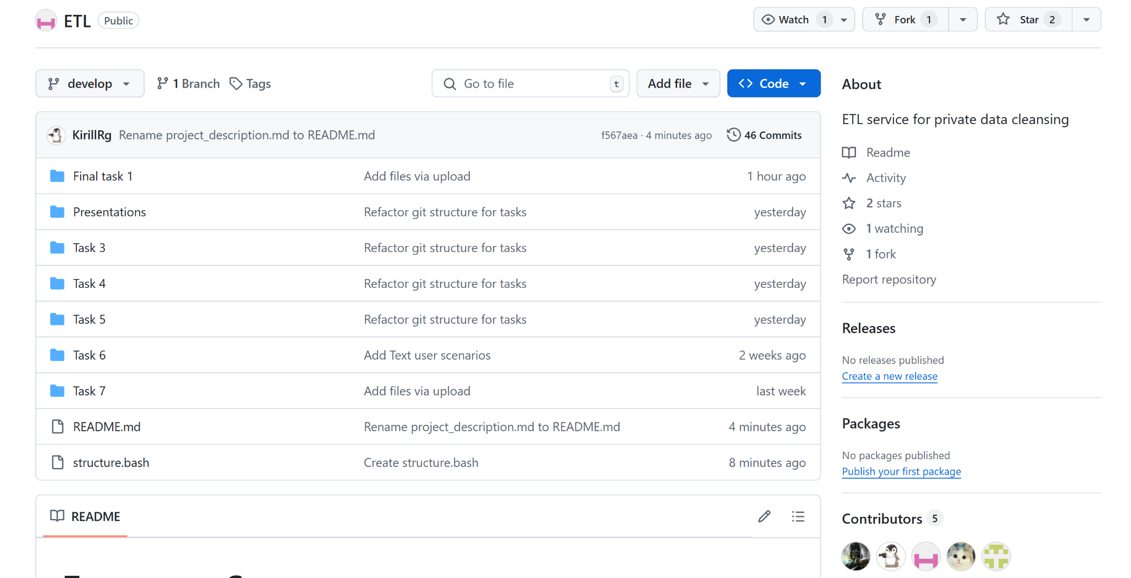
Repository structure

Slide 27
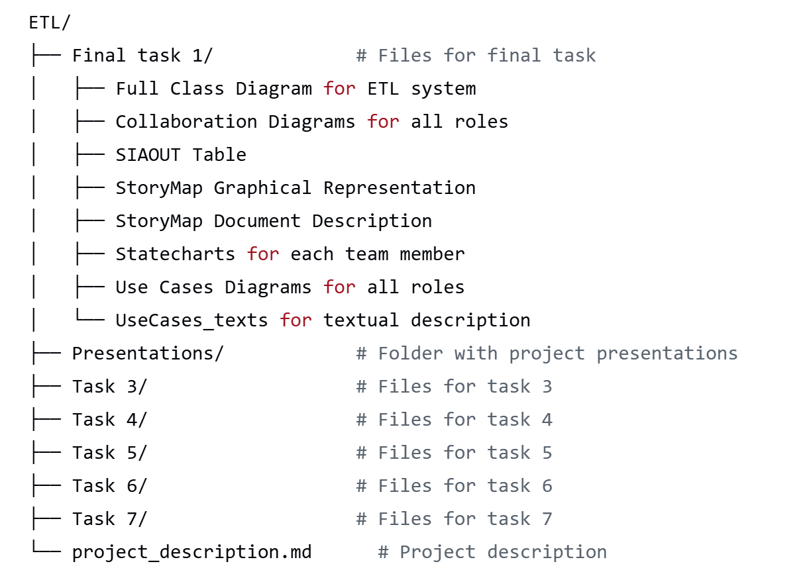
Repository structure

Slide 28





Team and roles
Name: Grapes
Group: МСПИН24
Sergey Rogachev (CRC|Use Cases|Class Diagram for ETL Process) / tg:@VRskyline
Denune Pravira(SIAOUT for ETL | Use Cases | Story Map | Activity Diagram for logging)/
tg: @alanprawira
Anoshenko Daniil
(Personas + CRC|Use Cases|Class Diagram for DevOps)
@tg:NeoVoodoo
Pham Manh (SIAOUT | Story Map | Use Cases | Activity Diagram for Reporting) / tg:@fammanh
Rogoza Kirill (StoryMap + CRC|Use Cases|Class Diagram for Logging and Reporting) / tg:@krogoza

